Slide 1
Introduction to TensorRT

Slide 2
Why do we train deep learning models?
Training requires a lot of data and high computational requirements.
The end goal is to deploy our trained models to perform inference on unseen data.
During the inference session,
We expect the model to give us results quickly.
We do not want our model to burden us with high computational requirements. Why?

Slide 3
What is TensorRT?
TensorRT is a C++ library that is designed to facilitate high performance inference on GPUs.
It creates a light-weight runtime engine to deploy to the production environment usually by taking trained deep learning models irrespective of the frameworks and optimizing them.

Slide 4
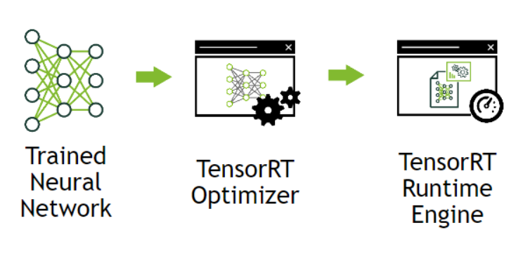

Slide 5
Model deployment
Use the framework used for training itself to perform inference.
Lower performance on a given GPU.
Optimizations that we do during training focus majorly on efficient training.
Develop an application using low-level libraries and math operation.
This task is very tedious.
Optimizations that work on one GPU may not work the same way on a different type of GPU.

Slide 6
Benefits of TensorRT
TensorRT enables the trained neural network to be compressed, optimised and deployed as a runtime engine without the overhead of a framework.
TensorRT optimizes the network by combining layers and optimizing kernel selection for improved latency, throughput, power efficiency and memory consumption. If specified, it also optimizes the network to run in lower-precision which reduces memory requirements further.

Slide 7
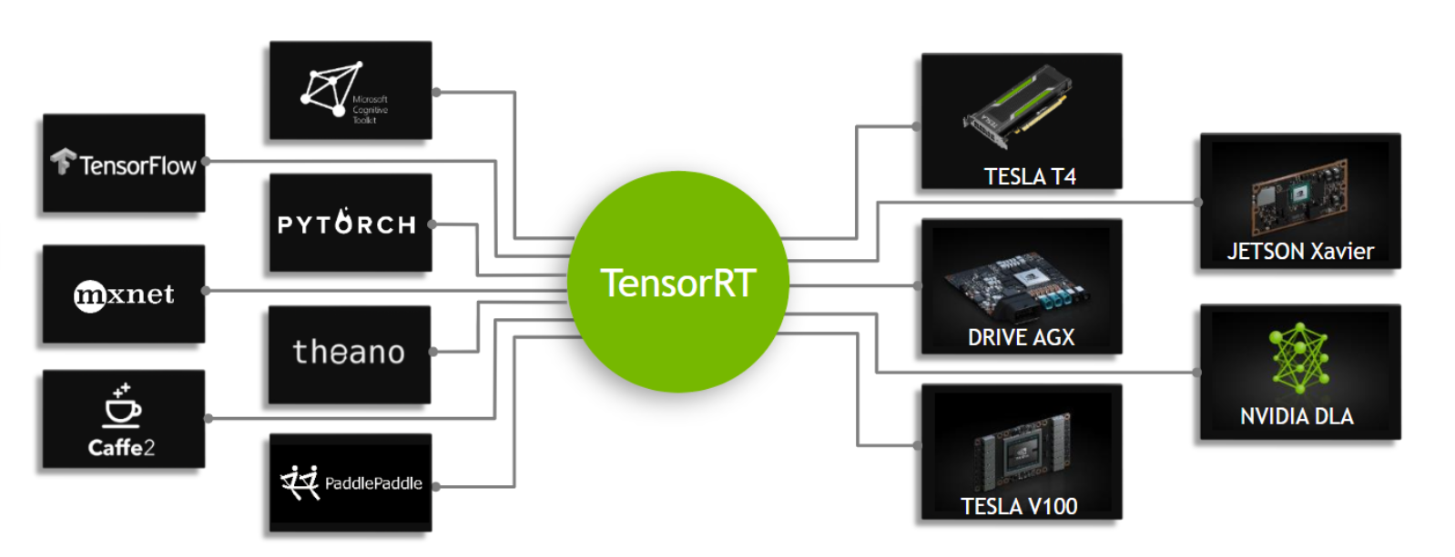

Slide 8
Stages in solving a problem with DL
Stage 1: Data acquisition, pre-processing and training the model.
Stage 2: Developing a deployable solution.
Stage 3: Deploying the solution.

Slide 9
By the end of stage 1, we’ll have a trained architecture.In stage 2, we develop the inference solution.
TensorRT takes the saved model and builds an inference engine. There are multiple ways to do this depending on the framework used for training.
In general, we need to take the save model and parse it from its saved format into TensorRT using various parsers like ONNX parser, UFF parser or Caffe parser, etc.

Slide 10
What is a parser?
It is a compiler that breaks data (your model) into smaller elements for easy translation into another format.

Slide 11
How TensorRT works
Phase 1: Network definition: TensorRT takes the network from parser.
Phase 2: Build phase: A inference engine is generated.
Phase 3: Execution phase: To run the inference engine.

Slide 12
Phase 1: From parser to TensorRT
ONNX - Open Neural Network Exchange.
PyTorch model → ONNX model → TensorRT

Slide 13
Phase 2: Build phase
During build phase, following optimizations are performed on the layer graph:
Elimination of layers whose outputs are not used.
Elimination of operations which are equivalent to no-operation.
The fusion of convolution, bias and activation function operations.
Aggregation of other operations which share similar parameters and same source tensor.
Modifies the precision of parameters if specified.
The build phase takes a specific amount of time. Therefore, we build the engine once and then serialize it as a plan file for future use cases.

Slide 14
Phase 3: Execution phase
The inference engine is executed with actual inputs to the model.

Slide 15
Deployment
The application usually makes use of a plan file. To initialize the inference engine, the application will first deserialize the model from the plan file into an inference engine.

